Slide 2
WORRY

Slide 3

WORRY

Slide 4
DON’T WORRY!

Slide 5

Getting to the heart of our WORRY

Slide 6
Getting to the
heart of our
WORRY
- UNBELIEF
- IDOLATRY

Slide 7
Getting to the heart of our WORRY

Slide 8

DON’T BANK
ON EARTH…
…BANK IN HEAVEN!

Slide 9

DON’T BANK ON EARTH…
…BANK IN HEAVEN!
LOGICAL REASON:

Slide 10
DON’T BANK ON EARTH…
…BANK IN HEAVEN!
LOGICAL REASON:
THEOLOGICAL REASON:

Slide 11
WORRY = Money

Slide 12

IDOL = Money
WORRY = Money

Slide 13
Money Health Relationships
= WORRIES

Slide 14
IDOLS =
  Control Comfort
Money Health Relationships
= WORRIES

Slide 15
DON’T BANK ON EARTH…
…BANK IN HEAVEN!
LOGICAL REASON:
THEOLOGICAL REASON:

Slide 16
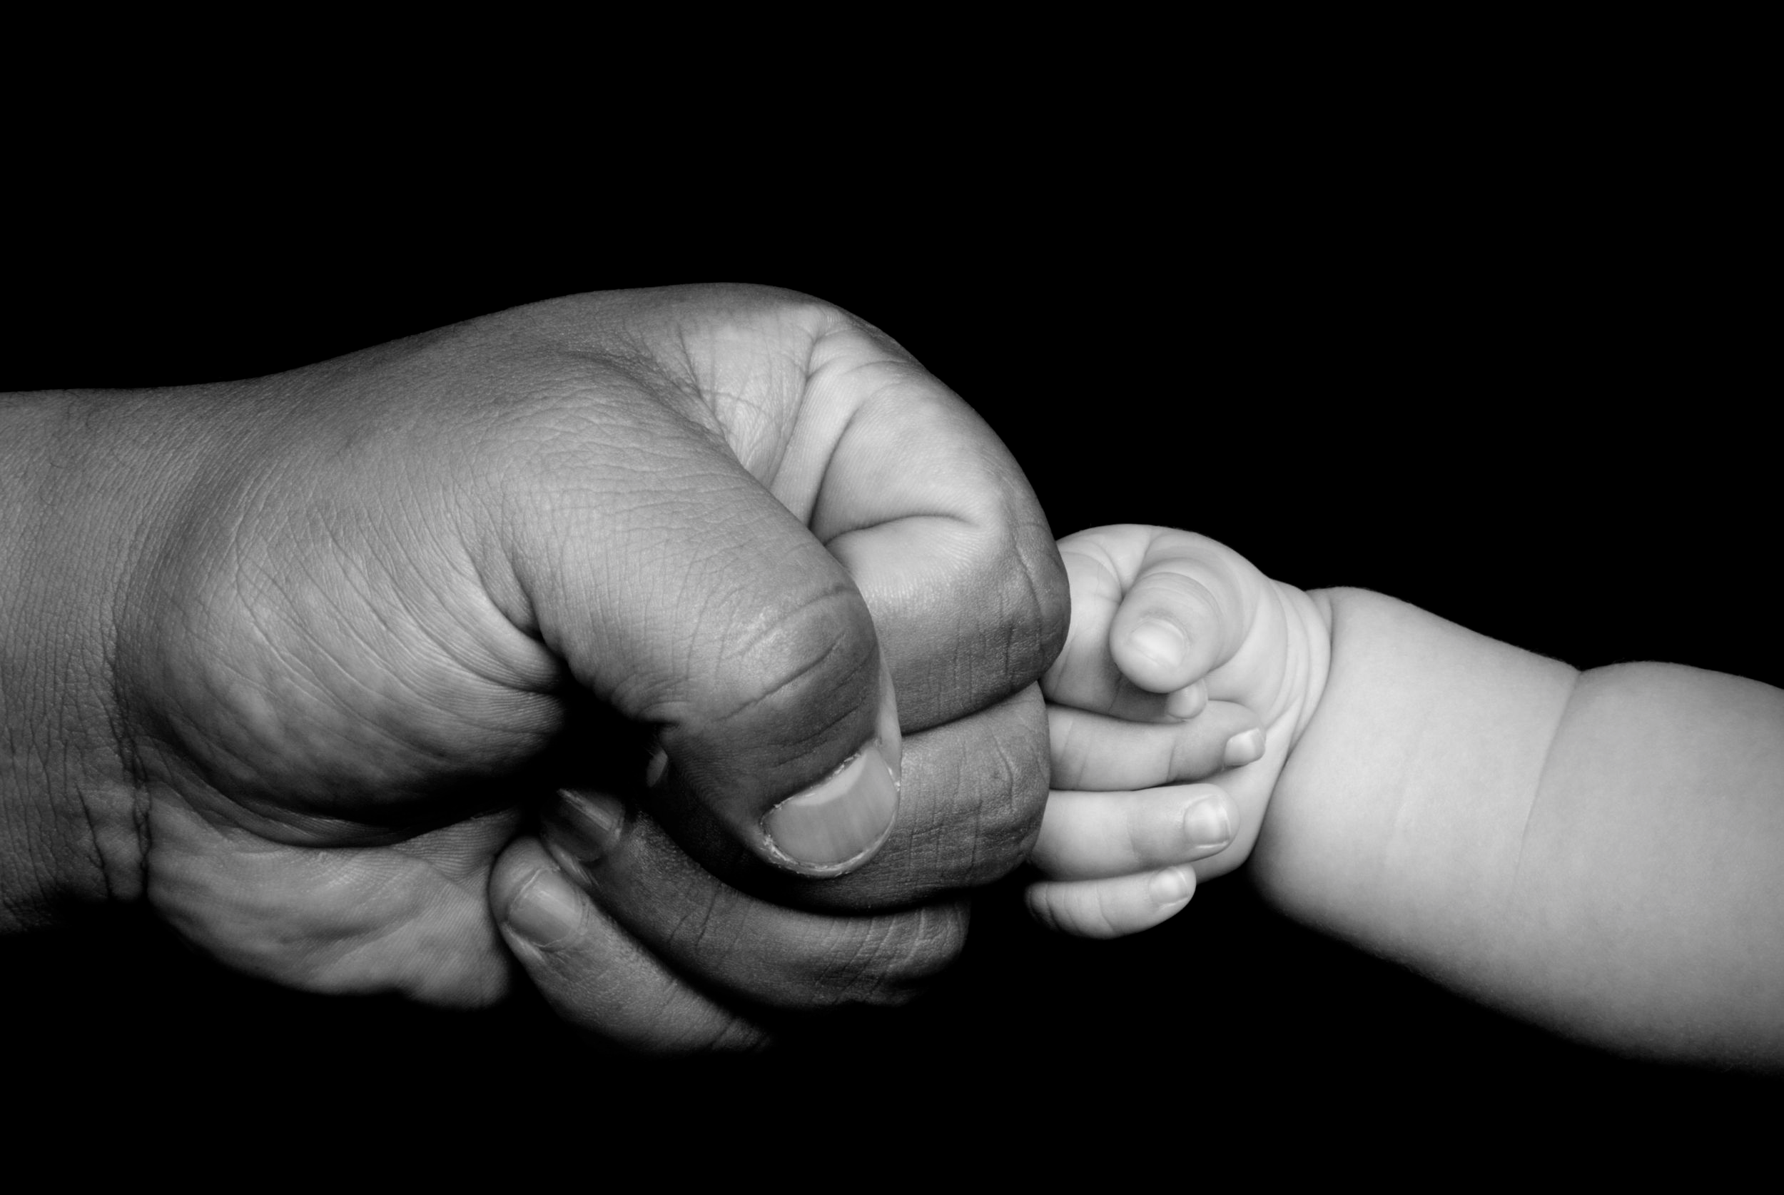
DON’T STRESS
LIKE AN ORPHAN…
…BE SURE OF
YOUR FATHER’S CARE!

Slide 17
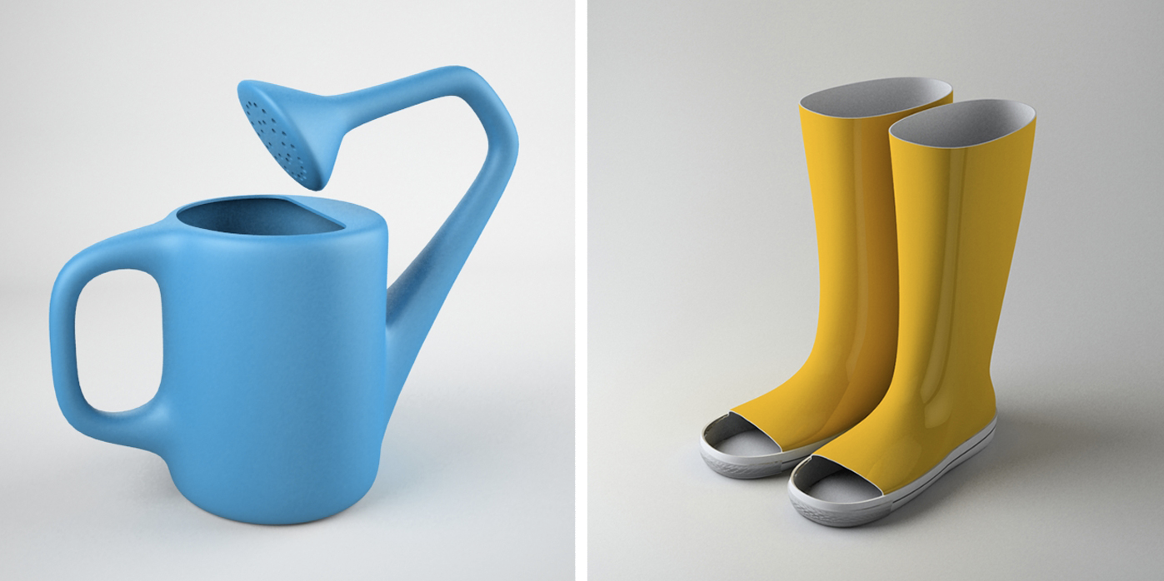
DON’T STRESS
LIKE AN ORPHAN…
…BE SURE OF
YOUR FATHER’S CARE!
LOGICAL REASON:

Slide 18

DON’T STRESS
LIKE AN ORPHAN…
…BE SURE OF
YOUR FATHER’S CARE!
LOGICAL REASON:
THEOLOGICAL
REASON:

Slide 19
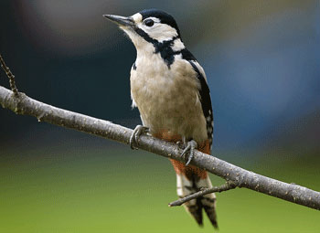

Slide 20
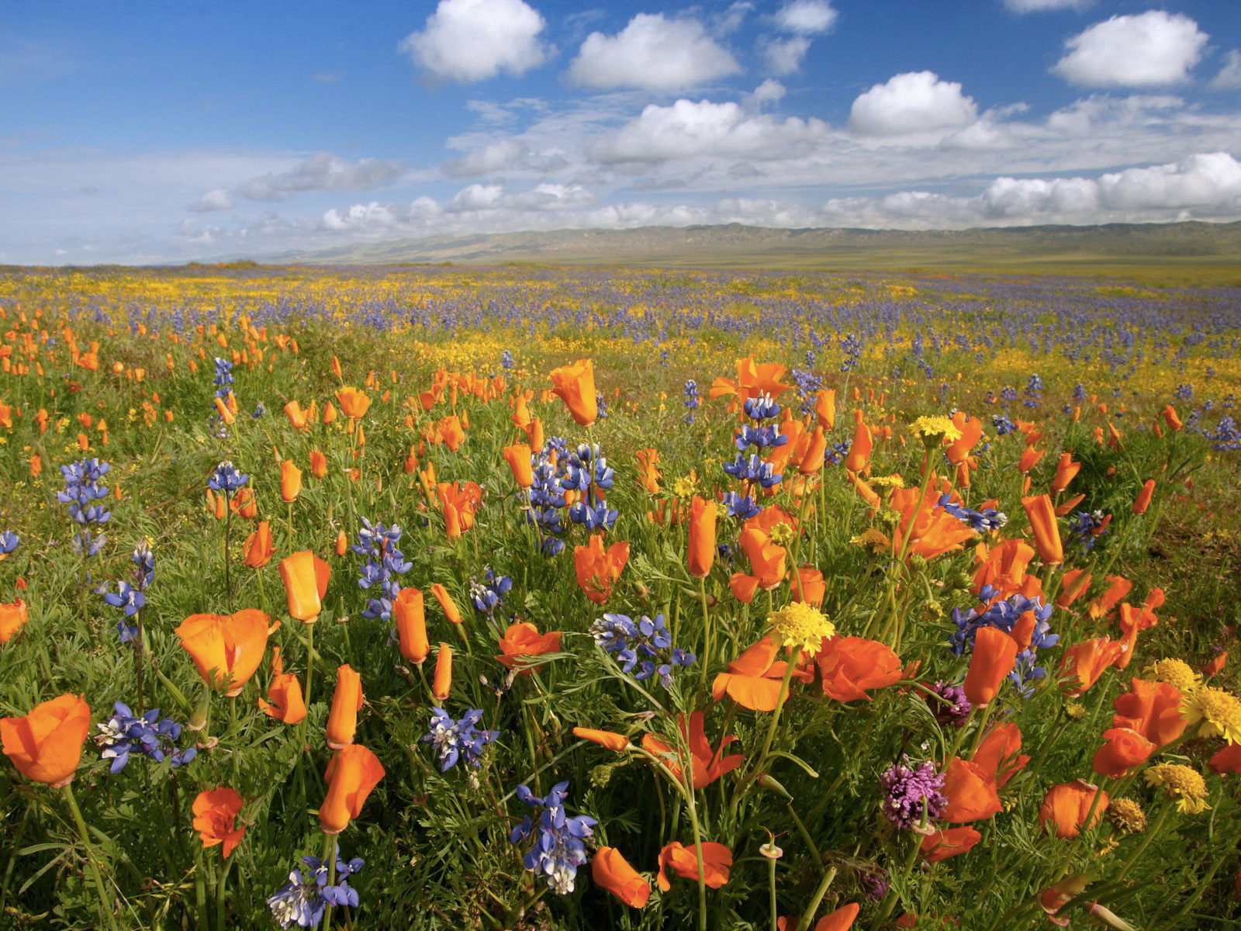

Slide 24
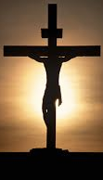

Slide 25
He who did not spare
his own Son, but gave him
up for us all - how will he
not also, along with him, graciously give us
all things?
Romans 8:32

Slide 26
DON’T STRESS
LIKE AN ORPHAN…
…BE SURE OF
YOUR FATHER’S CARE!

Slide 27
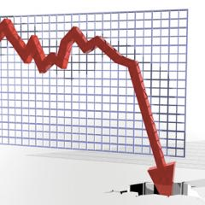
not yet a Christian?

Slide 28
not yet a Christian?
follower of Jesus?

Slide 29
not yet a Christian?
follower of Jesus?

Slide 30
not yet a Christian?
follower of Jesus?

Slide 31
not yet a Christian?
follower of Jesus?

Slide 32
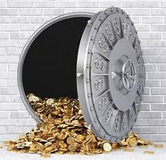
not yet a Christian?
follower of Jesus?

